Slide 1



WRHA Home Care Equipment
Bed Rails

Slide 2
Objectives & Outcomes
1. Identify risks and benefits of bed rails
2. Identify possible ways to reduce risks
3. Develop an operational directive for bed rails, that integrates current evidence, in order to update guideline from 2010.
4. Develop education handout for clients and caregivers.

Slide 3
OVERVIEW OF PRESENTATION
History of Bedrails
Review of Research
Health Canada
Entrapment Zones
  Stats
  Recommendations
Risk and Benefits of Bedrails
Methods for determining who is at risk
Alternatives to Bedrails
WRHA Long Term Care
WRHA Acute Care
WRHA Home Care
Current Status
Bed rails vs. Transfer Assist
Summary
Recommendations

Slide 4



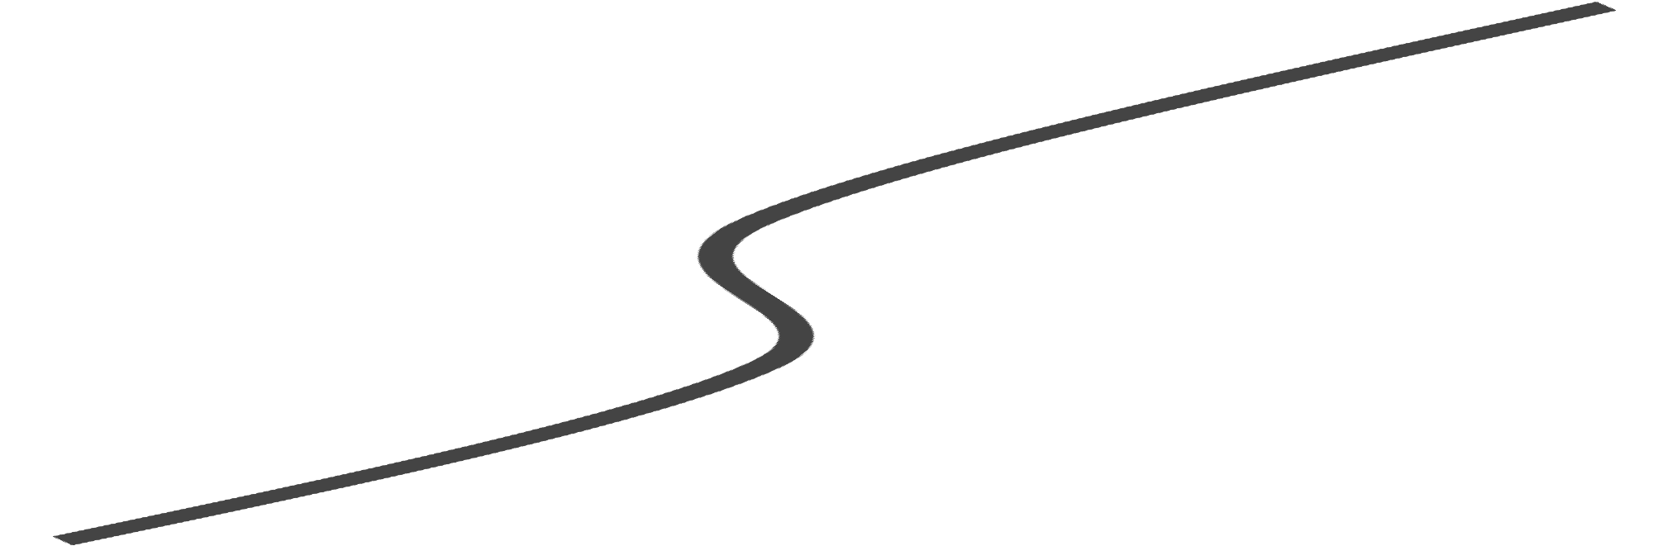









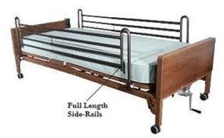


History of Bedrails
Side rail use is common practice in North America.
Increasing deaths and injuries from use and misuse lead to legal action against hospitals and staff.
1990’s
Increased use in North America due to:
Postwar nursing
Side rail use is first described as a physical restraint. Questioning of side rails as best practice.
shortage ( caregiver
1980
to “watch” patients )
Change in law, making hospitals criminally liable for staff
Consumer marketing of safely features of side rails
1940
Side rails promoted as an expression of safe practice
1950
1960’s & 70’s
Continued use of side rails thought to be the result of a nursing shortage and the creation of semi- private and private accommodations
Florence Nightingale didn’t use side rails!

Slide 5
Research
In the research found bed rails are not clearly defined (i.e. length, weight-bearing, stationary vs. fold away).

Slide 6


RESEARCH
Cognitively impaired people view bed rails as a barrier to exiting, choosing to either go around, over the end or over top the rails, thus increasing the likelihood of an injurious fall and possible entrapment or death.
Older People Falling Out of Bed: Restraint, Risk and Safety Hughes, R (2008)

Slide 7
RESEARCH
The Effect of bedrails on falls and injury: a systematic review of clinical studies. Healey et al. (2008).
A total of 24 papers met the criteria for a systematic review.
Populations included hospitals and Long-term care facilities. No community based studies.
They suggested that 12 studies reported direct injuries from the use of bed rails.
.

Slide 8
RESEARCH
The highest level of evidence gained from 5 prospective before-and-after studies of bedrail reduction:
  Interventions were focused on reducing the use of bedrails as much as possible.
  The populations included nursing homes, rehabilitation units for older adults, and a dementia care unit.
  Rates of falls in clients were then measured before and after the intervention (6 months to 2 years pre/post).

Slide 9
RESEARCH
Findings:
One study found a non-significant reduction in falls. (dementia, rehab, and hospice units).
One study found a significant reduction in serious injury requiring neurological observation (rehab unit)
Two studies found significant increase in falls and one described an significant increase in multiple falls. (nursing home, rehab unit)
Subsets of visually impaired patients, and those with a history of stroke experienced significantly increased rates of falls. (rehab unit)

Slide 10

Conclusion
“Whilst the evidence is limited in the quality and quantity of published evidence it does not however support the position that bed rail use should be routinely eliminated completely due to its intrinsic link to causality and risk of falls or restrictive practices.”

Slide 11
RESEARCH
Limitations:
The deterioration of health over the course of the studies could confound the findings
Concurrent changes in staffing, treatment, and client characteristics could confound the findings
Bed rail reduction studies also included the concurrent implementation of additional interventions (i.e. crash mats, movement alarms, hip protectors) are unlikely to account for increased falls but may increase the reporting of falls.

Slide 12
RESEARCH
High Frequency of Potential Entrapment Gaps in Beds in an Acute Hospital. Haugh, J. et al. (2014).
Assessed 60 beds in a large Irish teaching hospital for entrapment risk

Slide 13
RESEARCH
Findings:
At least one-fifth of bedrails use was inappropriate for all patients and at least one-third was inappropriate for patients with abnormal mental status.
Reasons given by staff for bedrail use supported the notion that bedrails were being used, unadvisedly, as a restraint for many patients.

Slide 14
RESEARCH
Findings (continued):
Abnormal mental states and difficulty transferring from bed remain the main predictors of bedrail use in hospitals
2 main issues: mattresses were the wrong size, usually too narrow or their perimeters were too compressible and secondly, bedrails were loose or poorly maintained with bent or worn components which allowed significant lateral movement.

Slide 15
Risks of Bed Rail Use
Increase in incidence/severity of injury (strangling, suffocating, bodily injury) and/or death
Increases the distance a client falls from the bed resulting in more serious injury
Functional decline –clients who are able to get out of bed are prevented from performing routine activities e.g. going to the bathroom or retrieving something from a closet

Slide 16


Risks of Bed Rail Use
May worsen agitation/confusion
Loss of dignity/freedom
Emotional distress: humiliation, anger, hopelessness
Separation of caregiver from care receiver
Potential increase in incontinence, pressure injuries, pneumonia, deep vein thrombosis by restricting mobility

Slide 17
Benefits of Bed Rail Use
Aids in turning and repositioning in bed
May provide hand-hold for getting in/out of bed
Provides a feeling of comfort and security (for some)
May reduce risk of falling out of bed
Provides easy access to bed controls

Slide 18
Balancing the Risks
Most decisions about bedrails are a balance between competing risks. The risks for individual clients can be complex and relate to their physical and mental health needs, the environment, their treatment, their personality and their lifestyle.

Slide 19

Who is at risk?
People who have problems with memory, sleeping, incontinence, pain or who get out of the bed and walk unsafely without assistance, are at highest risk for entrapment within bed or climbing over rails and falling out of bed.

Slide 20
Individualized Assessment for Bedrails
Ask client’s preference for side rails
Consider reason for side rail use
Client’s history of falls/falls risk assessment
Mental status/patterns of behavior
Level of mobility / transferring ability
Continence and toileting
Medications (sedatives, diuretics etc.)
Disease Pathology (e.g. pain)
Type of mattress or bed

Slide 21
The points to consider during risk assessment include:
  Is the person likely to fall from their bed?
  If so, are bed rails an appropriate solution or could the risk of falling from bed be reduced by means other than bed rails
  If not an appropriate solution, can an alternative method of bed management be used?
  Could the patient climb over the bed rails?
  Could the patient injure themselves on the bed rails?
  Could using bed rails cause the patients distress?

Slide 22
EXAMPLES OF RISK ASSESSMENT TOOLS

Slide 23
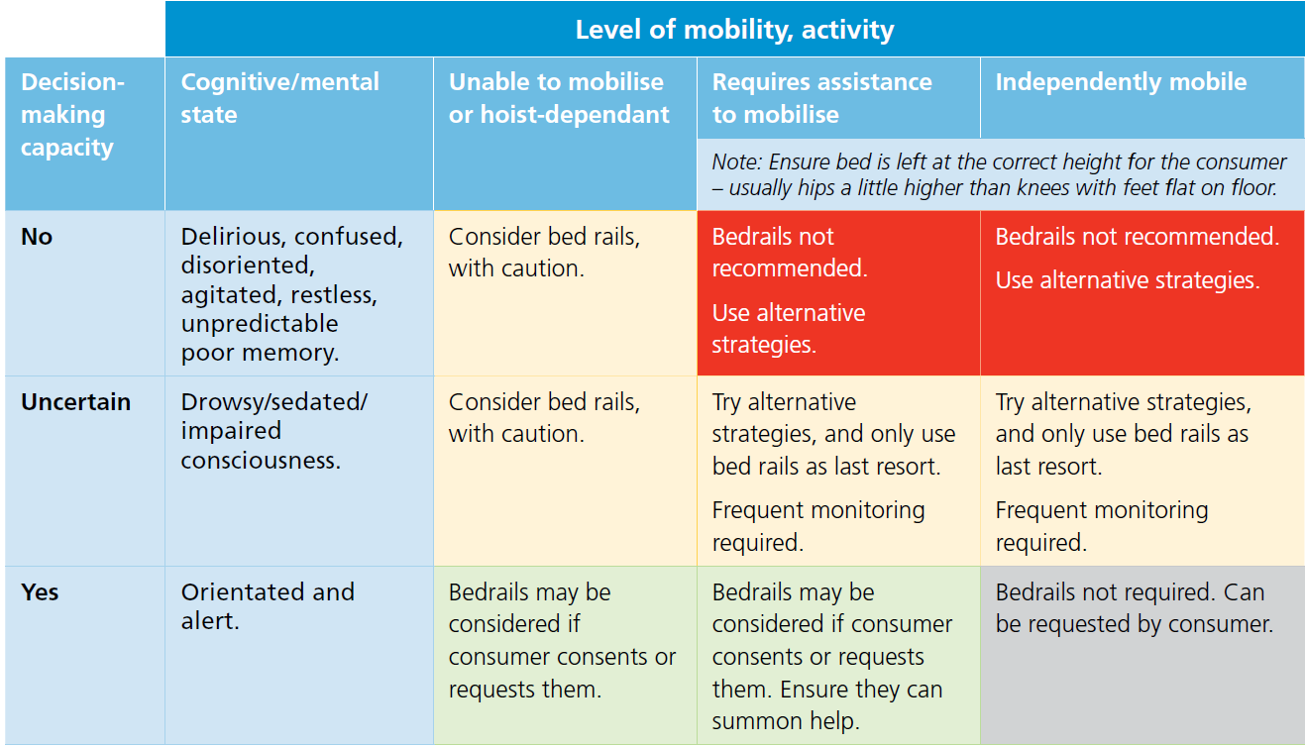
Fall and fall injury prevention and management toolkit: Safe use of Bed Rails. Government of Southern Australia, SA Health. (2015)

Slide 24
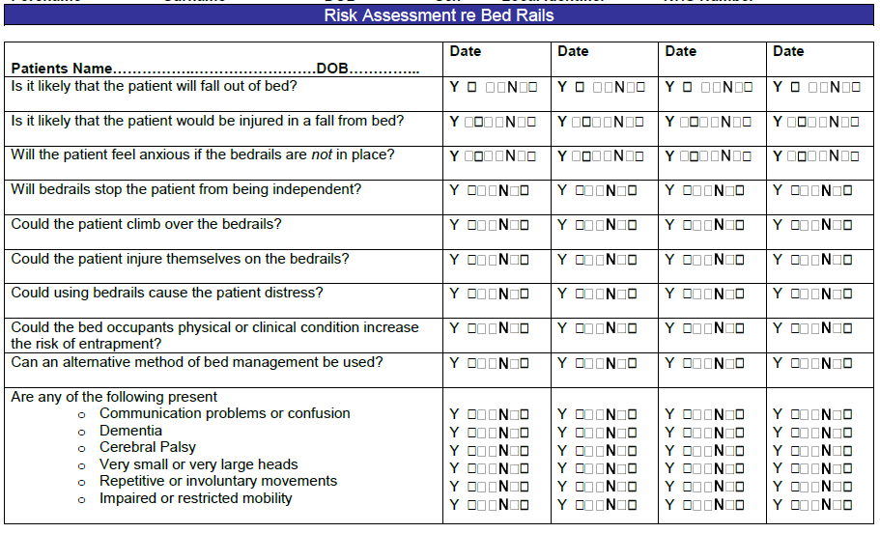
Fall and fall injury prevention and management toolkit: Safe use of Bed Rails. Government of Southern Australia, SA Health. (2015)
Notes:
The bold responses are the desired outcome. If any of the other boxes have been ticked there may be a risk of entrapment or
falls. Review other alternatives such as low bed, alarm system, increased level of observations.
Use bedrails if the benefits outweigh the risks.

Slide 25
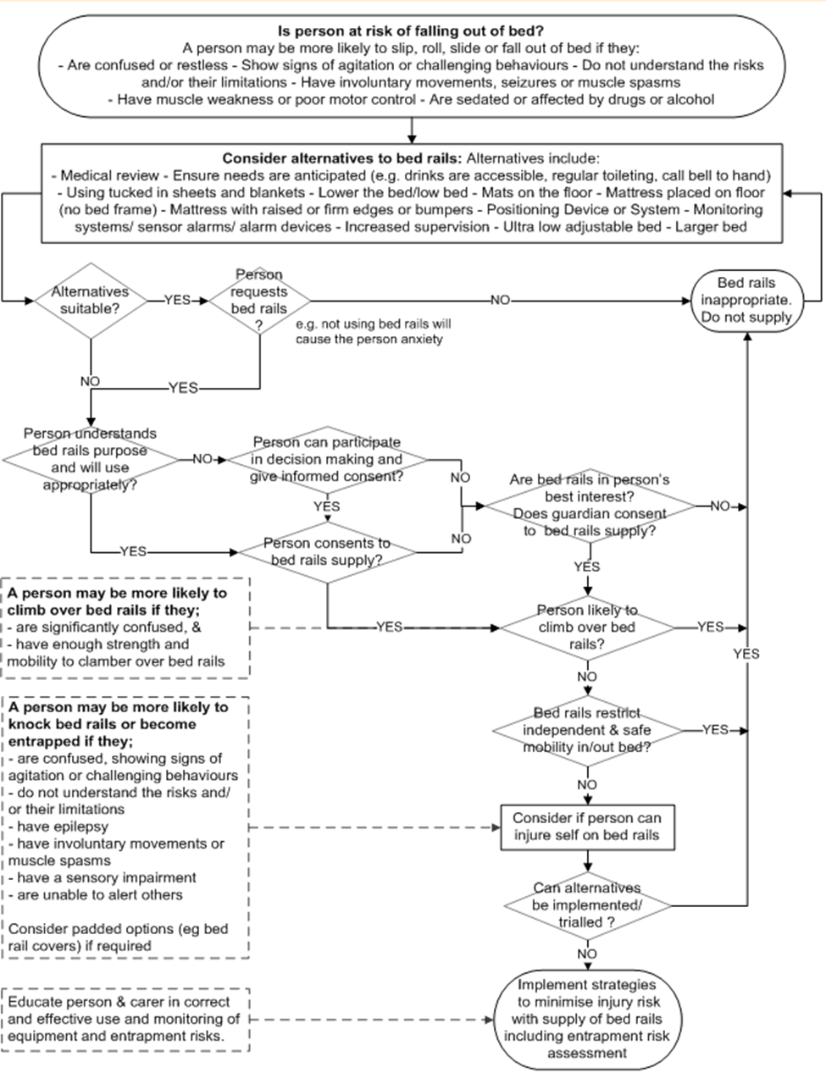

Slide 26
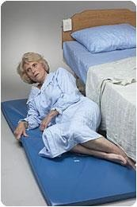
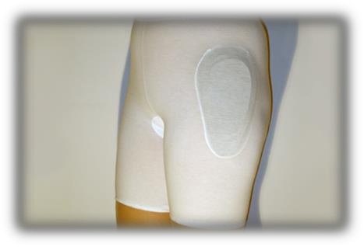
Alternatives to Bed Rails
Lower the bed to the most appropriate height for the resident (with wheels locked)
Consider a bed that lowers to the floor
Mobility aid within reach
Fall mat(s) on floor
Hip protectors
Ceiling to floor poles
Baby Monitors

Slide 27

Health Canada
In March 2008, Health Canada published a guidance document entitled “Adult Hospital Beds: Patient Entrapment Hazards, Side Rail Latching Reliability, and Other Hazards” to provide recommendations to assist healthcare facilities in assessing side rail use in health care settings.

Slide 28

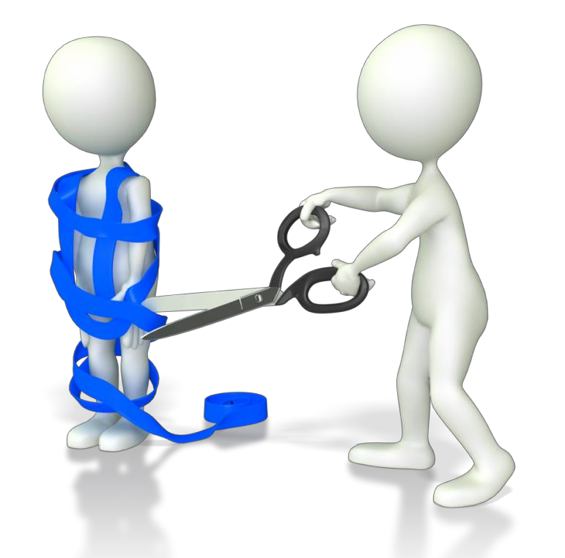
Bed Entrapment
The term “entrapment” describes an event in which a resident is caught, trapped or entangled in the space in or about the bed side-rail, mattress, or hospital bed frame.

Slide 29
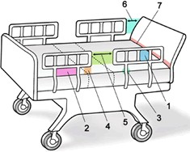
7 Potential Entrapment Zones
Zone 1: Within the Rail
Zone 2: Under the Rail, Between the Rail Supports or Next
to a Single Rail Support
Zone 3: Between the Rail and the Mattress Zone 4: Under the Rail at the Ends of the Rail Zone 5: Between Split Bed Rails
Zone 6: Between the End of the Rail and the Side Edge of the Head or Foot Board
Zone 7: Between the Head or Foot Board and the Mattress End

Slide 30

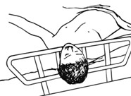
Zone 1: Within the Rail
Any open space within the perimeter of the rail.
Openings in the rail should be small enough to prevent the head from entering.
– A loosened bar or rail can change the size of the space.

Slide 31

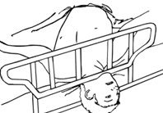
Zone 2: Under the Rail, Between the Rail Supports or Next to a Single Rail Support
gap under the rail between a mattress compressed by the weight of a resident's head and the bottom edge of the rail

Slide 32

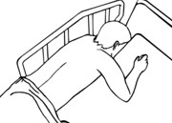
Zone 3: Between the Rail and the Mattress
The space between the inside surface of the rail and the mattress compressed by the weight of a resident's head.

Slide 33

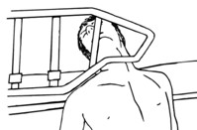
Zone 4: Under the Rail at the Ends of the
Rail
The gap that forms between the mattress compressed by the resident, and the lowermost portion of the rail, at the end of the rail.
The space poses a risk for entrapment of a resident's neck. It may change with different rail height positions and as the head or foot sections of the bed are raised and lowered.

Slide 34

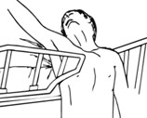
Zone 5: Between Split Bed Rails
Where partial length head and foot rails (split rails) are used on the same side of the bed.
The space between the split rails may present a risk of either neck entrapment or chest entrapment between the rails if a resident attempts to, or accidentally, exits the bed at this location.
V-shaped opening between the rails may present a risk of entrapment due to wedging.

Slide 35


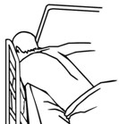
Zone 6: Between the End of the Rail and the Side Edge of the Head or Foot Board
The space between the end of the rail and the side edge of the headboard or footboard.
Any V-shaped opening between the end of the rail and the head or footboard may present a risk of entrapment due to wedging.
This space may change when raising or lowering the head or foot sections of the bed.

Slide 36


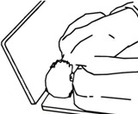
Zone 7: Between the Head or Foot Board and the End of the Mattress
The space between the inside surface of the head board or foot board and the end of the mattress.
This space may present a risk of head entrapment when taking into account the mattress compressibility, any shift of the mattress, and degree of play from loosened head or foot boards.

Slide 37

The Stats on Entrapment
Between 1980 and March 2017, Health Canada received 126 incidents of life threatening bed entrapments in Canada, 44 of which led to deaths.
  Between October 2009 and August 2012, 12 incidents and 3 deaths occurred. 8 out of the 12 cases occurred in nursing homes or long-term care facilities while the remaining incidents happened in hospitals (3) or at home (1). *(Only time period that setting is stated)

Slide 38
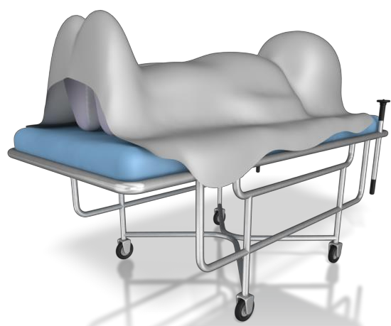
The Stats on Entrapment
Entrapment events account for almost one fifth (18.3 %) of all types of reported bed use problems, and account for 63% of bed use related deaths.
There is an incident reported almost every 3 months in Canada where an entrapment or rail latch failure occurs. Since device incidents generally tend to be under-reported, the number of actual entrapment deaths is likely higher.
Although the occurrence of entrapment events is rare, when they do occur, the outcome can be fatal yet is often preventable!

Slide 39
Hospital Bed Related Deaths
Bed related deaths between 1975 and 2006 were examined at the Department of Forensic Medicine at A University hospital:
Bedrail related (entrapment) 23%
Fixation related (involving a restraint) 32%
Patient Hoist related 15%
Falling out of bed 15%
Manuel strangulation/hanging 15%
De Letter, Els A et al. Hospital Bed Related Fatalities: a Review.(2008)

Slide 40
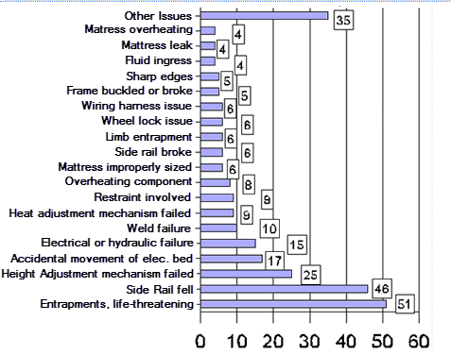
Incidence of bed problems - Reported to Health Canada 1980 to April 2006

Slide 41
Health Canada
Recommendations made:
Assess clients to determine if the use of bed rails is appropriate for each individual patient and closely monitor patients for which bed rails are used. Consider mental status, mobility, falls risk, anxiety levels with bed rail use, and medications
Take steps to reduce risks
  Evaluate hospital beds to test for entrapment zones
  Ensure all beds are routinely maintained
  Make sure to replace worn or broken parts, including the mattress and bed rail, with compatible ones.

Slide 42
WITHIN WRHA: LONG TERM CARE

Slide 43
The Bed Safety Working Group
LONG TERM CARE
Developed Bed Safety: Long Term Care Program Resource Guide to provide interventions to mitigate and/or manage the risks of electric beds.
  Outlines the role of each member of the interdisciplinary teams role (Nursing, HCA, Rehab assistant, Physiotherapy, Occupational Therapy)
  Stated bed systems should be tested at minimum every two years and when there are changes to any part of the bed or when maintenance is required for entrapment risk. Bed System Safety Measurement Test Form

Slide 44
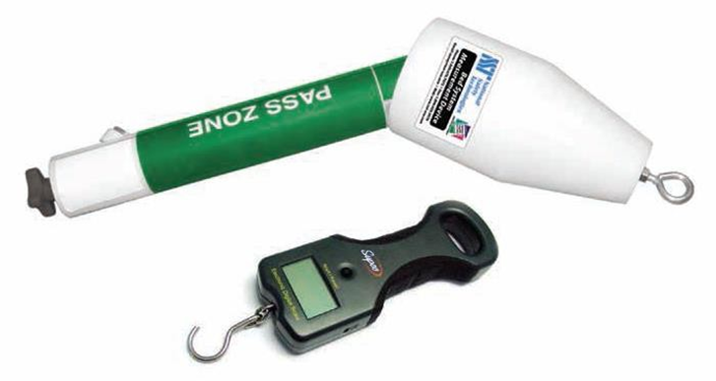
The Bed Safety Working Group
LONG TERM CARE
Bed System Safety Measurement Test Form

Slide 45
The Bed Safety Working Group
LONG TERM CARE
Created a handout for residents/families regarding the risks and benefits of bed rails.
Created a learning companion to educate staff members about entrapment risks and how to test entrapment zones.
Created a Restraint policy

Slide 46

Policy # 110.130.050 Restraints in Personal Care Homes (Safe Use of) 2015:
Physical or Mechanical Restraint: Devices that the individual cannot remove at will and which restrict freedom of movement. This includes, but is not limited to:
two full or three-quarter bed rails in the up position;
one full or three-quarter bed rail in the up position on a bed when the other side of the bed is against a wall;
Outlines a process for assessment and use of bed rails

Slide 47
WRHA ACUTE CARE

Slide 48
WRHA ACUTE CARE
Developed a restraint policies (2017) along with:
  Frequently Asked Questions document
  A Guide for Patients and Family poster/handout
  Case Study Educational Tool
  Separate restraint policy for Children’s
Entrapment Assessments
  No written policy/program in place
  Done by Clinical Engineering or Faculty Management staff
  All hospitals have test kits and have completed training on entrapment assessment
  Assessment part of service/repair to beds

Slide 49
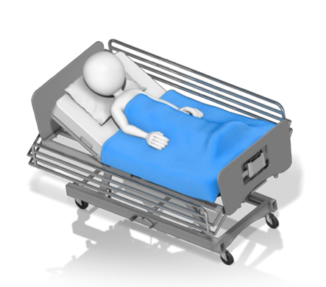
Policy # 110.000.025 Restraint Minimization – Acute Care Facilities (Adult)
Physical or Mechanical Restraint: A manual or physical device that the individual cannot remove and which restricts freedom of movement. Examples include…having all bed rails in the up position

Slide 50
ACUTE CARE
3.6 Restraints shall NOT be:
3.6.3 Used in the form of bed rails inhibiting free movement, except under 3.5
3.5 Restraint use shall require:
3.5.1 A comprehensive interprofessional assessment
3.5.2 An order by an Authorized Prescriber;
3.5.3 Verbal informed consent from the Patient, family and/or Substitute Decision-Maker.
3.5.4 An individual plan of care specific to the needs of the Patient, including steps to mitigate the potential negative impact of the Restraint use; and
3.5.5 Ongoing reassessment and documentation.

Slide 51
ACUTE CARE
3.7.2 Bed rails when required specifically for safe Patient monitoring in the peri-operative period when the Patient has not yet returned to their pre-operative level of consciousness. This may include but is not limited to Post - Anesthetic Care Units (PACU), intensive care (ICU), and Emergency Department (ED);

Slide 52
Policy: Child Health Falls Prevention and Treatment Guidelines
Place bed in the lowest position. If child is unattended lower side rails.
Assess need for bed side rails for unattended children who independently climb out of bed. Document rationale for using bed rails for the unattended child in patient health record. Consider the need for constant attendant if bedrails are required and the child demonstrates risk for climbing over the rails

Slide 53
WRHA Home Care: Current Status

Slide 54

Bed Rails Guidelines (2010)
Bed rails must not be used as a restraint. Consult the Home Care Team Manager if you suspect that bed rails are being used for this purpose
Clients and caregivers should be cautioned about possible bed rail danger and advised to report loose, bent, broken, and/or malfunctioning bed rails immediately to the CC.
Creation of a safe bed environment should take into account client’s nighttime habits, medical needs, comfort, freedom of movement and independence with turning and positioning in bed.

Slide 55
Current Status
Currently not doing any of the following:
Assess client appropriateness - staff are not specifically provided training in this area some health care professionals would have this knowledge
CCs may/may not reassess the appropriateness of bed rails at annual reviews depending on their level of knowledge. Hundreds of “equipment only” clients with no reassessments
No regular maintenance.
No testing of entrapment zones
No education for staff, clients, or families
No restraint policy

Slide 56
Home Care Equipment Numbers- standard beds only does not include bariatric or falls prevention beds (Jan. 2019)
Old Style Beds in use 1223
  ½ Bed Rails 2220 97%
  Full Bed Rails 59 3%
Newer Style Beds in use 1297
  ¼ Transfer Assist Rails 592 25%
  ½ Transfer Assist Rails 1574 66%
  Swivel Transfer Assist Rails 20 1%
  ¾ Bed Rails 189 8%

Slide 57
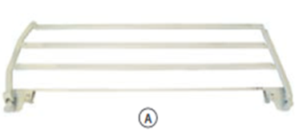
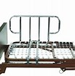
Definition of Bed Rail
(as per WRHA Home Care)
A rail along the side of a hospital bed and anchored to the frame which can be folded down. Designed to assist with rolling from side to side and to help position oneself in bed. Available in full, three-quarter and half-length depending on the bed
Bed rails are not a handhold to assist with getting into and out of bed and should not be ordered if downward pressure on the bed rail is being applied to assist with bed transfer.

Slide 58
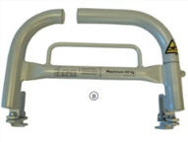
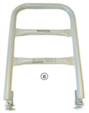
Definition of Transfer Assist Rail
(as per WRHA Home Care)
Transfer Assist Rail: A rail along the side of a bed and anchored to the frame and cannot be folded down. Designed to assist with rolling from side to side and to help position oneself in bed, as well as a handhold to assist with getting into and out of bed. Available in quarter and half length, as well as a swivel option. Only available on newer beds.

Slide 59
Summary
1. ENTRAPMENT TESTING/REGULAR MAINTENANCE- deferred but needs to be addressed in the future.
2. ASSESSING THE CLIENT/MONITORING THE CLIENT
The wholesale elimination or use of bedrails is not supported by evidence.
Bed rails/transfer assist rails should not be used routinely and use should only be based on individual assessment .
Alternatives should be considered whenever possible.
Bed rail/transfer assist rail use should be reviewed on a regular basis

Slide 60
Recommendations
Develop or incorporate a risk assessment tool, with a decision making map or algorithm.
Mandatory assessment demonstrating client is appropriate for use of ¾ and full length rails. These rails should not be used as a means to “keep client in bed” as option of least constraint is ideal.
Continue the use of transfer assist rails to increase bed mobility and transfer assistance.
Develop educational handouts for staff, clients, caregivers regarding potential risks and the use alternative methods for client safety (i.e. Hi/Low beds, falls prevention mats, bed exit alarms etc.)

Slide 61
References
Cumbria Partnership NHS Foundation Trust. (2017). BED RAILS -SAFE AND EFFECTIVE
USE OF BED RAILS.
De Letter, Els A et al. Hospital Bed Related Fatalities: a Review.” Medicine, Science and the Law 48.1 (2008): 37–50. Web.
Haugh, J. et al. High Frequency of Potential Entrapment Gaps in Beds in an Acute Hospital. 43.6 (2014): 851–856. Web.
Healey, Frances et al. The Effect of Bedrails on Falls and Injury: a Systematic Review of Clinical Studies. Age and ageing 37.4 (2008): 368–378. Web.
Health Canada. (2015). Adult Hospital Beds: Patient Entrapment Hazards, Side Rail Latching Reliability, and Other Hazards. https://www.canada.ca/en/health-canada/services/drugs-health-products/medical-devices/application-information/guidance-documents/guidance-document-adult-hospital-beds-patient-hazards-side-rail-other-hazards.html
Health Canada. (2012). Notice to Hospitals - Health Canada Issued Important Safety Information Update on the Risk of Entrapment of Patients in Hospital Beds. http://www.healthycanadians.gc.ca/recall-alert-rappel-avis/hc-sc/2012/14796a-eng.php
.

Slide 62
References
Hughes, Rhidian. Older People Falling Out of Bed: Restraint, Risk and Safety. The British Journal of Occupational Therapy 71.9 (2008): 389–392. Web
Long Term Care Bed Safety Working Group. (2018). BED SAFETY Long Term Care Program Resource Guide.
Long Term Care Bed Safety Working Group. (2018). WRHA Long Term Care (LTC) Program Bed Safety Resource Guide Self-Learning Companion.
SA Health Safety and Quality Unit. (2015). TOOL 3: Safe use of bed rails.

